Slide 1
Demonstration 1
Presenting to: CPSC 233 T02
Summer 2019
Khushi B., Harrison C., Allen S., Vahbiz B. (Team 5)
Presenters: Harrison C., Khushi B.

Slide 2
Executive Summary
Proposal
Design Methods
Demonstration
Q&A
Improve information consumption from University calendar | Prioritizing user functions | Logical flow of code | External Opportunities
Create an interactive calendar app | Build calendar, input events, color coding for different types of events | Implementation and design challenges | Feedback

Slide 3
Project Proposal/Goal
Challenge: Improving usability of UofC calendar resources (specifically for the students)
Solution: Creating an interactive calendar app that pre-populates calendar information for users and allows for user customization

Slide 4
Where we are so far (current status)
Text-Based Version:
from command-line, prompts user input for:
event name
event date
event description
categorization for personal or other event
then prints all this info line-by-line
this will be converted into an interactive calendar format for the GUI

Slide 5
Class Diagram

Slide 6
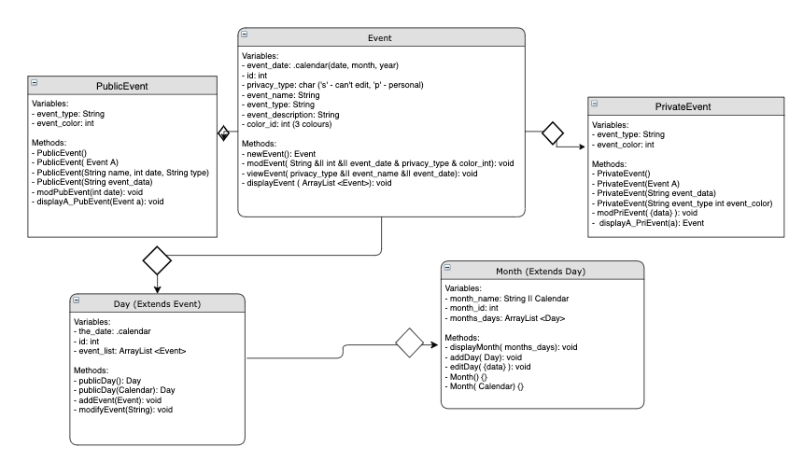
Class Diagram

Slide 7
Code Design and Functionality
designed to make it simple for users to understand and interact
colour coding
organization of code into clearly labelled classes that are relevant to the interface of the application (event, day, month) makes it easier to pinpoint where issues lie
manageability is a major component of this type of design

Slide 8
Changes/Modifications
UofC API access - discarded
Notification System - discarded
Interactive UofC Maps - discarded

Slide 9
Project Demonstration

Slide 10
Challenges and Resolutions
CHALLENGES
Resolutions
Working with Java Calendar Library | Utilizing the javadocs and looking for calendar best practices
Ensuring appropriate event-object mapping | Selecting an appropriate calendar design that optimizes usability and display to user

Slide 11
Executive Summary
Proposal
Design Methods
Demonstration
Q&A
Improve information consumption from University calendar | Prioritizing user functions | Logical flow of code | External Opportunities
Create an interactive calendar app | Build calendar, input events, color coding | Implementation Challenges | Feedback

